Slide 1
Business Income Schedule C
Pub 4012, Tab D
(Federal 1040-Line 12)
(NJ 1040-Line 17)
Notes:
1

Slide 2
Business Income Self Employed - Schedule C
In business for self as a sole proprietor or independent contractor
Trade or business carried on with expectation of making a profit
Must report sales, expenses & net profit on Schedule C
Loss - OUT OF SCOPE
A self-employed person performs a service & controls at least one of the following:
Who, What, Where, When & How
Notes:
2
Remind counselors that we use Schedule C, not Schedule C-EZ

Slide 3
Definitions Related to Schedule C
Business: Continuous & regular activity with income as primary purpose
Employee: Employer controls when, where, & how the employee works
Independent Contractor: Performs services for others
Self-Employed for Tax Purposes
Note: Household employees (baby sitters, cleaning help, home health aides, etc) income is taxable to employee – Out Of Scope for Payer
Notes:
3

Slide 4
Requirements for Business Income to be In Scope
Business expenses of $10,000 or less
Cash method of accounting (not accrual)
No inventory
No net loss from business
Only one sole proprietor business
No employees
No Depreciation/Amortization
No deduction for business use of home (Home Office). This includes the “simplified option for home office deduction”
No prior year disallowed passive activity loss
Notes:
4

Slide 5
Allowable Business Expenses
Pub 4491 Pages D-11
Advertising
Vehicle expenses
Standard mileage only
Commissions
Insurance
Interest
Office & rent expense
Repairs & maintenance
Supplies
Taxes
Travel
Utilities
50% of business meals/entertainment
Professional fees
Notes:
5
Emphasize that if taxpayer claims standard rate for mileage, TW will calculate the expense & include with other business expenses

Slide 6
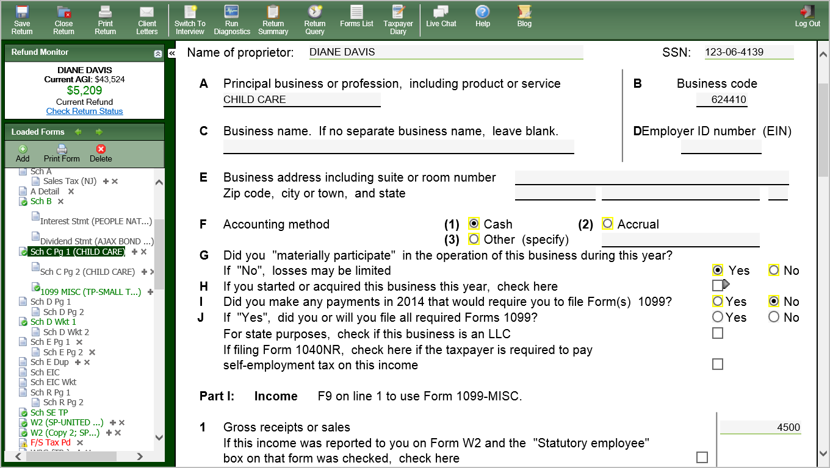
TW Schedule C Page 1
Pub 4012 Tab D
Must Link to 1099 MISC or scratch pad, or form association will be lost
Notes:
Schedule C screen
Link from Line 12 Business Income on 1040 Page 1 (using arrow or F9) OR
Click on Schedule C in Forms Tree
Answer general information questions about business that are underlined in red
Use “Schedule C Business Codes” lookup on TaxPrep4Free.org Preparer page to get Business Code
If no separate business address, leave blank and just “get the red out” if necessary
Business must use Cash method of accounting to be IN SCOPE (Line F)
Answer YES to “material participation” question on Line G
If you started business in 2014, click box on Line H
If you made payments that would require use of Form 1099, the return is OUT OF SCOPE
Enter Gross Receipts from business on Part I, Line 1
If taxpayer has 1099-MISC, link to 1099-MISC screen from Part I, Line 1 & enter appropriate data
If taxpayer has no 1099-MISC, enter business income into a scratch pad linked to Line 1. Use scratch pad so that income source can be documented
If taxpayer has both, link 1099-MISC and Scratch Pad with other income to Line 1. The total will appear on Line 1
6

Slide 7
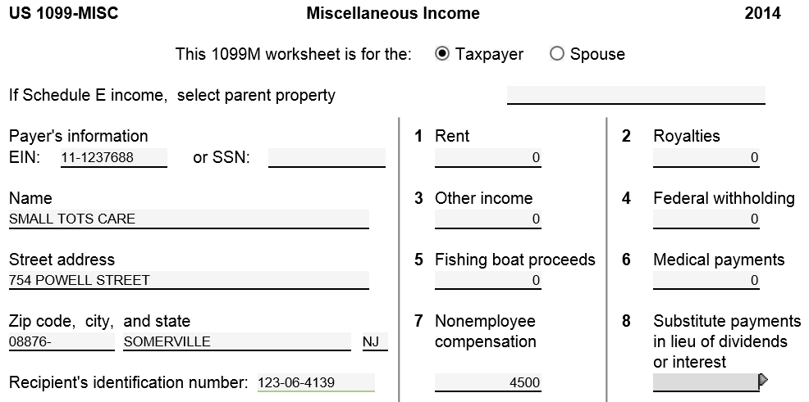
TW 1099-MISC for Business Income
Must link to 1099-MISC from Sch C Line 1 (do not just add new 1099-MISC
using Add button); otherwise, TW will not calculate self- employment tax
and adjustment
TW transfers to Schedule C Income
Notes:
LINK TO 1099-MISC FROM LINE 1 ON SCHEDULE C
If taxpayer received a 1099-MISC with nonemployee compensation in Box 7,
link from Line 1 on Schedule C to Miscellaneous Income screen & enter data from 1099-MISC. TW transfers data to Part I, Line 1 on Sch C
If you don’t link from Sch C Line 1 & just add a new 1099-MISC form from icon on top of TW screen, TW will not know to associate the income with Sch C. TW will just put income on 1040 Line 21 Other Income. TW will also not calculate self-employment taxes & associated adjustment to income as it should
If taxpayer has a 1099-MISC plus other business income
complete Miscellaneous Income screen for 1099-MISC. Then link to a scratch pad from Sch C Line 1 (under NEW, if not listed) & enter rest of business income. TW will add both amounts together on Line 1
7

Slide 8
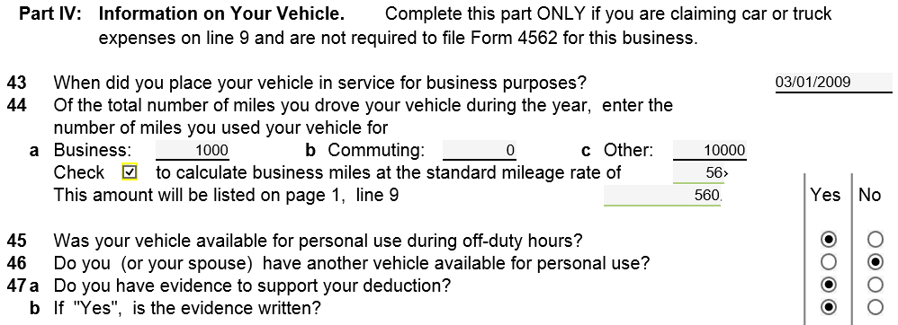
TW Schedule C Page 2 Part IV – Mileage Expenses
Pub 4012 Tab D
Check box for calculation
TW transfers to Schedule C Expenses Line 9
Notes:
If taxpayer is claiming mileage expenses on Schedule C (based on IRS standard rate), first answer questions in Part IV about the vehicle. TW will transfer total to Part II, Line 9
Standard mileage rate for 2014 is 56 cents per mile for business miles driven
Remember to check the box under Line 44a that says, “Check to calculate business miles at the standard mileage rate…”
What is Business Mileage?
Remember commuting to same business location is not a business expense; it’s commuting and cannot be claimed
If travelling to more than 1 business location on the same day, can claim miles between the 2 locations. Cannot claim mileage from home to first location or mileage from last location to home
8

Slide 9
TW Schedule C Page 1 Part II - Expenses
From Page 2 Part IV
Enter directly or on scratch pad
From Page 2 Part V Line 48
Notes:
Enter business expenses on the appropriate lines of Part II. Use a scratch pad if multiple expenses for one line
Can enter all expenses under Part V Other Expenses if you wish
TW will transfer vehicle expenses from Page 2, Part IV to Part II, Line 9. Do not have to re-enter on Line 9
9

Slide 10
TW Schedule C Page 1 - Net Profit
TW will calculate Net Profit & transfer to 1040 Line 12
NOTE: Out of Scope if Net Loss
Notes:
TW will calculate Net Profit on Part II Line 31 & transfer to 1040 Page 1 Line 12 Business Income
TW will calculate Self-Employment Tax (Medicare & Social Security) on Schedule SE & transfer result to 1040 Line 57
TW will populate adjustment to income for ½ of Self-Employment Tax on 1040 Line 27
10

Slide 11
TW 1040 Line 12 – Business Income
TW transfers from Schedule C
Notes:
11

Slide 12
Self-Employment Taxes
In 2014, Social Security & Medicare tax for persons who worked for themselves is 15.3% (12.4 + 2.9)
Same as amount withheld from employees’ wages
Must have net income from self-employment over $400 to owe self-employment taxes
Entry on line 1 of Schedule C will cause TW to:
Calculate Self-Employment Tax (Medicare & Social Security) on Schedule SE & transfer result to 1040 Line 57
Record Adjustment to Income for ½ of Self-Employment Tax on 1040 Line 27
TW computes all automatically
Notes:
12
When a 1099-MISC is received with box 7 filled in (rather than a W-2), it indicates non-employee and must pay self-employment tax if income exceeds $400
There are two places on return for Self-Employment tax:
1) Line 27- Adj to income for the deductible part of Self-Employment tax
2) Line 57- Other Taxes – for Self-Employment tax owed

Slide 13
TW 1040 Line 57 – Self-Employment Tax
TW calculates
Notes:
13

Slide 14
TW 1040 Line 27 – Deductible Part of Self-Employment Tax
TW calculates
Notes:
14

Slide 15
Schedule C - TW Tips
“Business Code” field
Use TaxPrep4Free.org Preparer page link to codes and search using Ctrl-F.
Employer ID Number (EIN)
If Taxpayer does not have an EIN, leave space blank; do not enter SS #
If taxpayer has no 1099-MISC for nonemployee compensation, enter business income on scratch pad linked to Part I Line 1 to document the income source.
If Taxpayer has 1099-Misc, link from Sch C Line 1 Gross Receipts to 1099-Misc.
If claiming business mileage at standard rate, answer questions in Part IV about auto. TW transfers mileage expenses to Part II Line 9
List other business expenses on appropriate lines
OK to use Part 5 to enter expenses except for mileage
Notes:
15

Slide 16
NJ Bus 1 & NJ Bus 2 Forms
When Schedule C is completed, NJ BUS 1 & 2 will be created in the NJ section of Forms Tree
If within scope for Sch C, no action is required on the NJ forms

